Slide 1
CMSC424: Database Design Module: Introduction/Overview
Instructor: Amol Deshpande
amol@umd.edu

Slide 2
Welcome to CMSC424: Database Design
Course description
Students are introduced to database systems and motivates the database approach as a mechanism for modeling the real world. An in-depth coverage of the relational model, logical database design, query languages, and other database concepts including query optimization, concurrency control; transaction management, and log based crash recovery. Distributed and Web database architectures are also discussed.
Basics
Typical in-person instruction, 2 classes a week etc.
Will record lectures but quality may not be as good
Plan to substitute a portion of the in-class teaching with videos + in-class activities
Will make available pre-recorded videos from Fall 2020
Expect about 75% overlap
Use the discussion forums, office hours as much as possible – assignments are to be done individually, but you are allowed to discuss among yourselves
Fill out the survey covering your background, your expectations, and potential issues (on Gradescope)
No Laptops without permission !

Slide 3
Logistics
Instructor: Amol Deshpande
5154 IRB, amol@umd.edu
Class Webpage: ELMS
Email to me: write CMSC424 in the title
Only if Piazza not suitable for some reason
Piazza allows private posts
TAs: Xinchen Yang, Fnu Ferry, Vanshika Mehta, Ayush Sood

Slide 4
Logistics
Textbook:
Database System Concepts
Seventh Edition (6th Edition will be fine too)
Abraham Silberschatz, Henry F. Korth, S. Sudarshan
GitHub:
To distribute programming assignments and Slides
https://github.com/umddb/cmsc424-spring2024
Piazza: First resort for any questions
ELMS: General announcements will be posted there
GradeScope
We will use this for assignments, grading exams, etc.

Slide 5
Grading
3 Midterms – 30%
20-25 mins at the beginning of the class
Final (30%) – minimum of 50% on this + midterms combined to pass
6 Assignments (24%) + Setup (1%)
SQL, Advanced SQL, SQL + Programming Languages, Normalization/E-R Models (not programming), MongoDB, Spark
Late Policy
Automatic one-week extension without penalty, but with an explanation of why
Beyond that: submissions allowed through the end of the semester with penalties
Assignment-0 (Setup) due next Friday
In-class Activities (15%)
Each week – will devote some time in the class to do some worksheets
Videos to watch before Tuesday class each week (starting next) – aim to release by Friday night

Slide 6
ChatGPT etc.
Feel free to use for learning purposes
e.g., to debug issues with set up, or to understand some concepts better
Beware of the hallucination and other issues
Will try to provide some starting points and prompts
Not allowed for directly solving assignments, although debugging would be acceptable

Slide 7
CMSC424: Database Design Module: Introduction/Overview
Background; What We Will Cover
Instructor: Amol Deshpande
amol@umd.edu

Slide 8
Motivation
Book Chapters (6th Edition)
1.1, 1.2, 1.3, 1.4, 1.9 (to some extent)
Key Topics
Why managing large volumes of data is difficult
Database Systems and Architectures
Data Models and Data Abstraction
What we will cover in this course

Slide 9
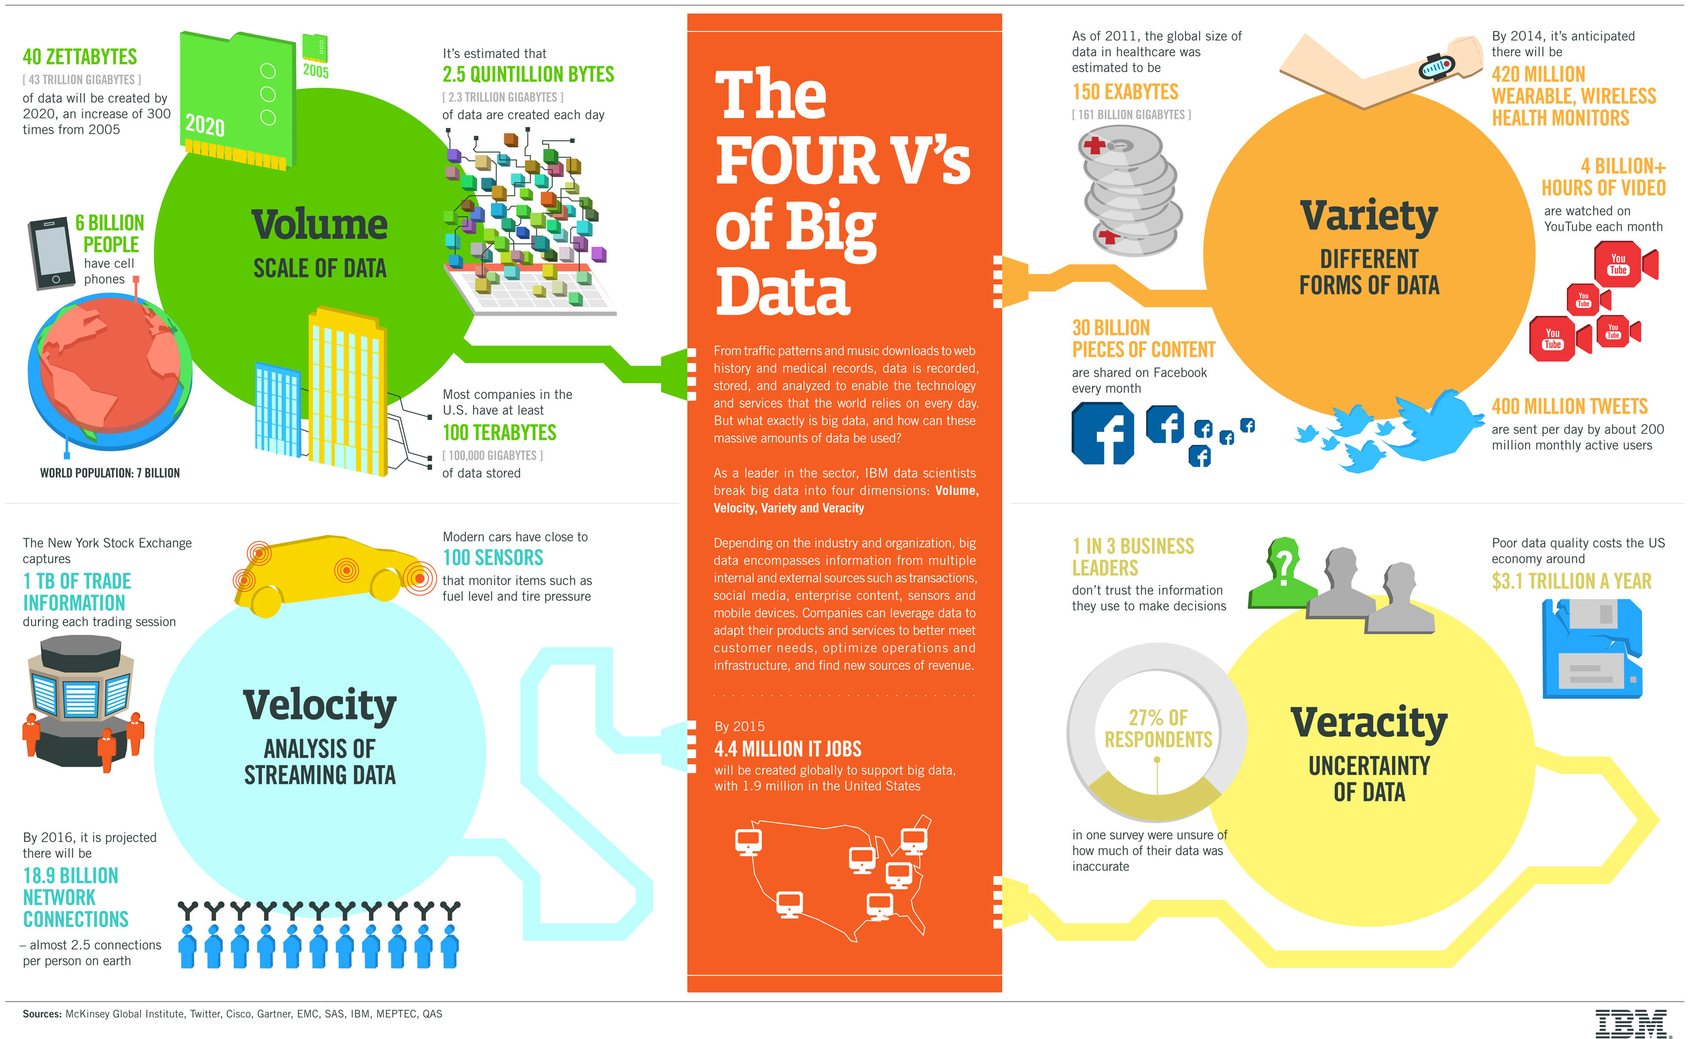

Slide 10
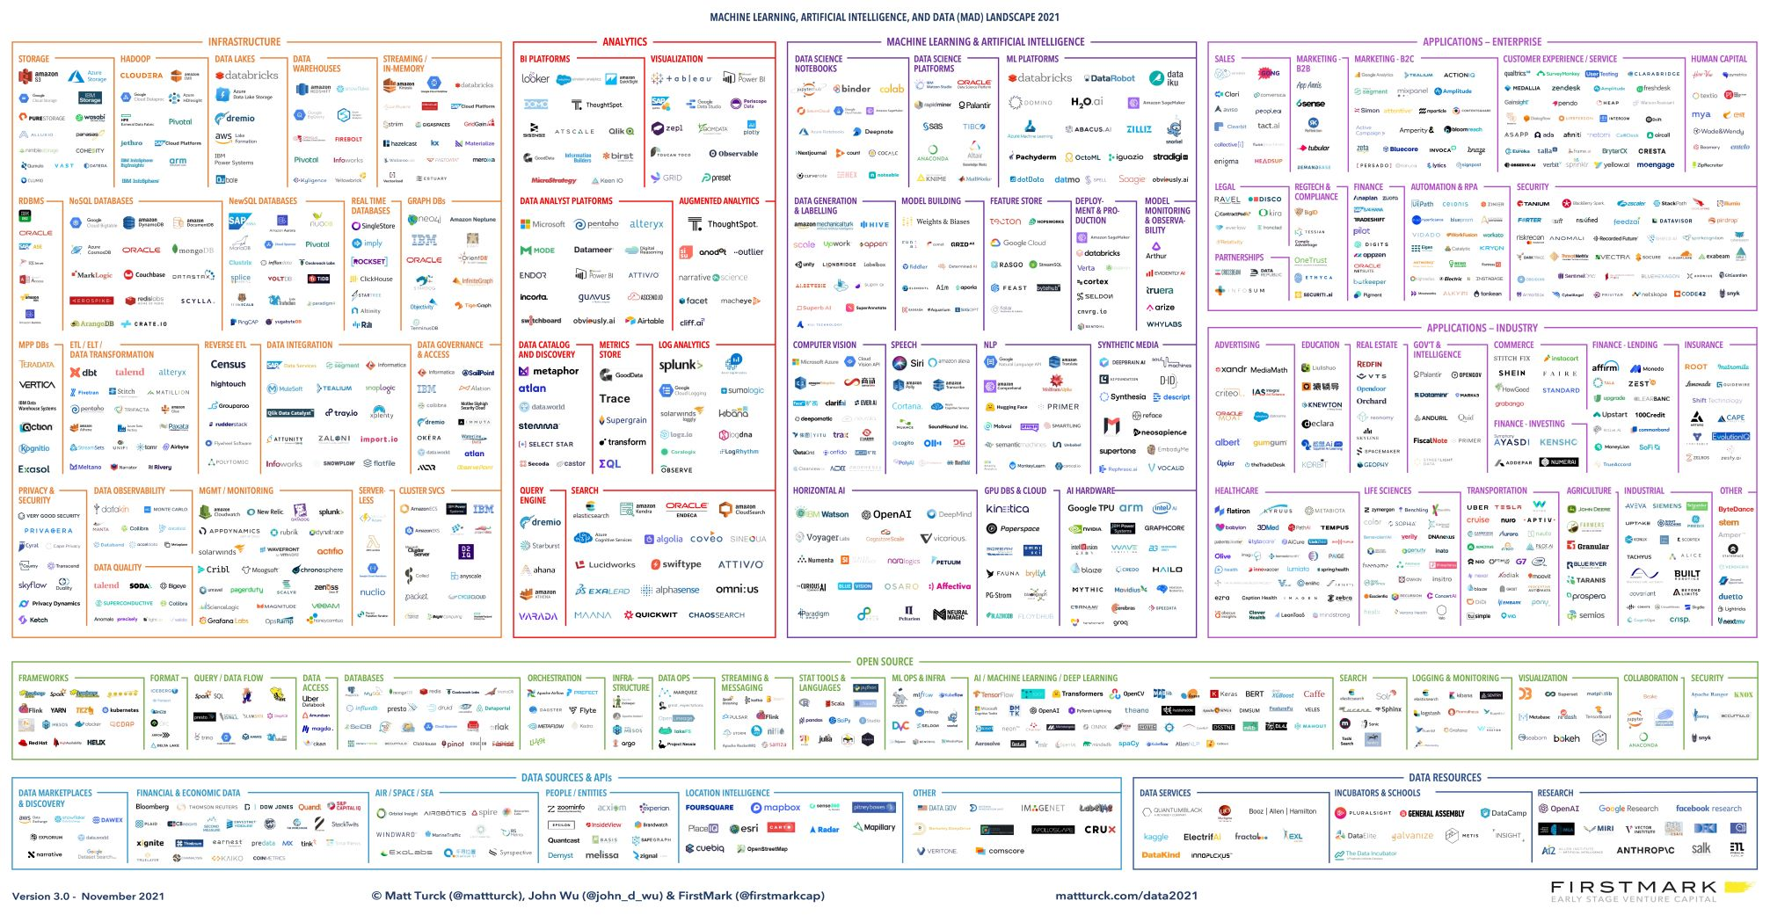
Data Management Systems
Data management systems at the center of most of the new innovative technologies
An incredible amount of ongoing work in building new types of systems

Slide 11
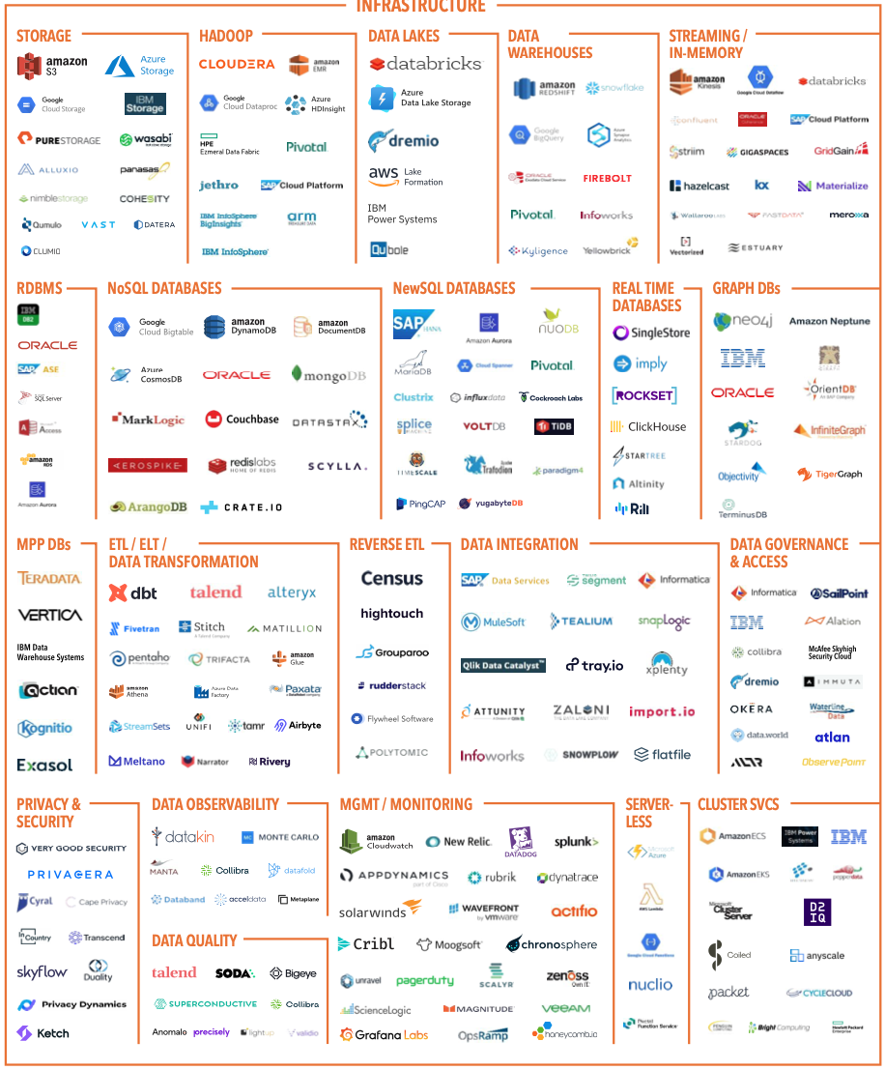

Slide 12
Data Management
A large fraction of the data still in traditional DBMS systems
Still open and active research areas about improving performance, energy efficiency, new functionalities, changing hardware spectrum (SSDs) and so on…
Much of the data not stored in traditional database systems today
For a variety of fairly valid reasons
- Stream processing systems (focusing on streaming data)
- Special-purpose data warehousing systems (most start from some RDBMS)
- Batch analysis frameworks (like Hadoop, Pregel, Spark, …)
Typically data stored in distributed file systems
- Key-value stores (like HBase, Cassandra, Redis, …)
Basically persistent distributed hash tables
- Semi-structured/Document data stores (for XML/JSON query processing)
- Graph databases
- Data lakes (e.g., scientific data, machine learning data)
However, many lessons to be learned from database research
We see much reinvention of the wheel and similar mistakes being made as early on

Slide 13
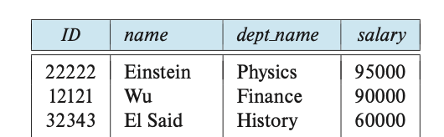
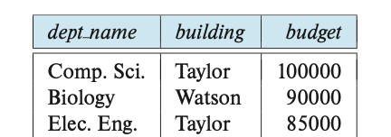
Data Management Challenges (1)
How to “represent”/”model” the data so users can easily understand, query, analyze, and update?
This is about the “logical” representation rather than “physical” -- we will worry about physical representation later
Whatever format we use needs to be easy for humans to work with, over a long period of time as data and usage evolves
As tables (like Excel)?
JSON Documents?
Graph?
Instructor: ID = 22222
{“instructors”: [
{“ID”: “22222”,
“name”: “Einstein”,
“dept_name”: “Physics”,
….
},
….
Department: Physics

Slide 14
Data Management Challenges (1)
How to “represent”/”model” the data so users can easily understand, query, analyze, and update?
This is about the “logical” representation rather than “physical” -- we will worry about physical representation later
Whatever format we use needs to be easy for humans to work with, over a long period of time as data and usage evolves
Many questions…
Pros and cons of different ways to do this
How to discuss whether our chosen data format is good or bad
e.g., some ways of storing data may increase conflicts in the data
How to deal with changes to the requirements and types of data being stored
Backwards compatibility is a huge problem leading to messy representations later on
Data Modeling

Slide 15
Data Management Challenges (2)
How to query the data? How to process/analyze it ? (from users’/analysts’ perspective)
“find the stores with the maximum increase in sales in last month”
We can’t expect the users to write Java programs
“how much time from here to Pittsburgh if I start at 2pm ?”
Data is there (GPS, live traffic data), but requires predictive capabilities
Increasing need to convert “information” to “knowledge”: Data mining/Machine Learning
Predicting which TikToks/tweets to show, …
Needs to be easy to use, but powerful enough for what needs to be done
Otherwise users will simply take out all the data and write their own programs
Query Languages and Programming Abstractions

Slide 16
Data Management Challenges (3)
How to query the data? How to process/analyze it ? (from implementation perspective)
How to handle the increasing scale of the data
How to support more and more complex analytics/machine learning over the data
How to process the data in real-time, as it is arriving into the system
How to find the best way to execute a query with least resources/time
How to utilize large numbers of machines to execute queries more efficiently
…
Database Query Engines
Big Data Systems

Slide 17
Data Management Challenges (4)
Modifying/updating the data given:
Many users simultaneously updating the data…
While the data is (potentially) replicated across the globe…
And any server or the network may go down at any point.
If allowed to run concurrently
a = a + 10
inc = a * 0.15
a = a + inc
b = b - 10
save a & b
b = b - inc
save a & b
Update 1
a = a + 10
b = b - 10
save a & b
Update 2
inc = a * 0.15
a = a + inc
b = b - inc
save a & b
Doesn’t happen if forced to run one after the other, but unacceptable performance

Slide 18
Data Management Challenges (4)
Modifying/updating the data given:
Many users simultaneously updating the data…
While the data is (potentially) replicated across the globe…
And any server or the network may go down at any point.
Update
a = a + 10
b = b - 10
save a
save b
Need to figure out how to handle
partially finished transactions
More complications if we do update-in-place
(i.e., a = a + 10 updates the original value)
System crashes

Slide 19
Data Management Challenges (4)
Modifying/updating the data given:
Many users simultaneously updating the data…
While the data is (potentially) replicated across the globe…
And any server or the network may go down at any point.
user 2
update b
update a
user 1
update a
update b
Geographically distributed replicas
data item a
date item b
data item a
date item b
data item a
date item b
Machine 1
Machine 2
Machine 3

Slide 20
Data Management Challenges (4)
Modifying/updating the data given:
Many users simultaneously updating the data…
While the data is (potentially) replicated across the globe…
And any server or the network may go down at any point.
From Users’ perspective:
What kinds of guarantees can be provided to the users about the end result, and about the order in which updates are made?
What if the users are okay with weaker guarantees?
From Implementation perspective:
How to provide the guarantees efficiently?
Transactions

Slide 21
Data Management Challenges (5-∞)
Data Integration, Transformation, and Cleaning
Large amounts of time spent in just getting data ready for analysis, by some accounts 90-95%
Real-world data has a lot of noise, missing values, etc…
Security
Access control, use of encryption, …
Privacy
How to allow users to query data without revealing it
How to enable public data releases (e.g., by Census Buereau)
…

Slide 22
Database System
A DBMS is a software system designed to store, manage, facilitate access to databases
Typically uses a specific data model, and
Supports some level of physical and logical data independence
Provides:
Data Definition Language (DDL)
For defining and modifying the schemas
Data Manipulation Language (DML)
For retrieving, modifying, analyzing the data itself
Guarantees about correctness in presence of failures and concurrency, data semantics etc.

Slide 23
Example: Relational DBMS and SQL
SQL (sequel): Structured Query Language
Data definition (DDL)
create table instructor ( ID char(5), name varchar(20), dept_name varchar(20), salary numeric(8,2))
Data manipulation (DML)
Example: Find the name of the instructor with ID 22222 select name from instructor where instructor.ID = ‘22222’

Slide 24
Example: MongoDB and MongoQL
Data definition (DDL)
Tuple/Row ➔ Document; Relation/Table ➔ Collection
db.createCollection("people")
Also, “insert” implicitly creates collections
Data manipulation (DML)
Example: Find all users with status = “A” and return user_id and status, but don’t return _id
db.people.insertOne(
{ user_id: "abc123",
age: 55,
status: "A" } )
db.people.find(
{ status: "A" },
{ user_id: 1, status: 1, _id: 0 } )

Slide 25
Data Abstraction
Probably the most important purpose of a DBMS
Goal: Hiding low-level details from the users of the system
Alternatively: the principle that
applications and users should be insulated from how data is structured and stored
Also called data independence
Through use of logical abstractions

Slide 26
Data Abstraction
View Level
What data users and application programs see ?
…
View 1
View 2
View n
Logical
Level
What data is stored ?
describe data properties such as
data semantics, data relationships
How data is actually stored ?
e.g. are we using disks ? Which
file system ?
Physical
Level

Slide 27
Data Abstraction
View Level
…
View 1
View 2
View n
Logical Data Independence
Protection from logical changes
to the schema
Logical
Level
Physical Data Independence
Protection from changes to the
physical structure of the data
Physical
Level

Slide 28
Data Abstractions: Example
A View Schema
course_info(#registered,…)
View Level
…
View 1
View 2
View n
Logical Schema
students(sid, name, major, …)
courses(cid, name, …)
enrolled(sid, cid, …)
Logical
Level
Physical Schema
all students in one file ordered by sid
courses split into multiple files by colleges
Physical
Level

Slide 29
Database Architecture: Pre-2000’s
All data was typically in hard disks or arrays of hard disks
RAM (Memory) was never enough
So always had to worry about what was in memory vs not
Almost no real “distributed” execution
Different from “parallel”, i.e., on co-located clusters of computers
Relatively well-understood use cases
Report generation
Interactive data analysis and exploration
Supporting transactions
From Chapter 20

Slide 30
Traditional RDBMS Architecture
Clients may be anywhere – e.g., ATMs, desktops, laptops, web apps etc.
Talk to the database using standard protocols like JDBC/ODBC, SOAP, or REST (today), or proprietary protocols
Some sort of load balancer or intake mechanism
Typical components in a database system: some for queries, some for transactions
Maybe on a single physical computer or a cluster connected by a fast network
Data Storage Systems:
Punch cards (long time ago)
Hard disks (still prevalent)
SSDs
Need “redundancy” and “fault-tolerance”
Data once stored should always be there
RAID = Redundant Array of Independent Disks

Slide 31
Database Architecture : Today
Much more diversity in the architectures that we see
More modern hardware architectures
Massively parallel computers
SSDs
Massive amounts of RAM – often don’t need to worry about data fitting in memory
Much faster networks, even over a wide area
Virtualization and Containerization
Cloud Computing
As a result: Data and execution typically distributed all over the place
Much more diversity in data processing applications
Much more non-relational data (images, text, video)
Data Analytics/Machine learning more common use-cases
Much more diversity in “data models”
Document data models (JSON, XML), Key-value data model, Graph data model, RDF

Slide 32
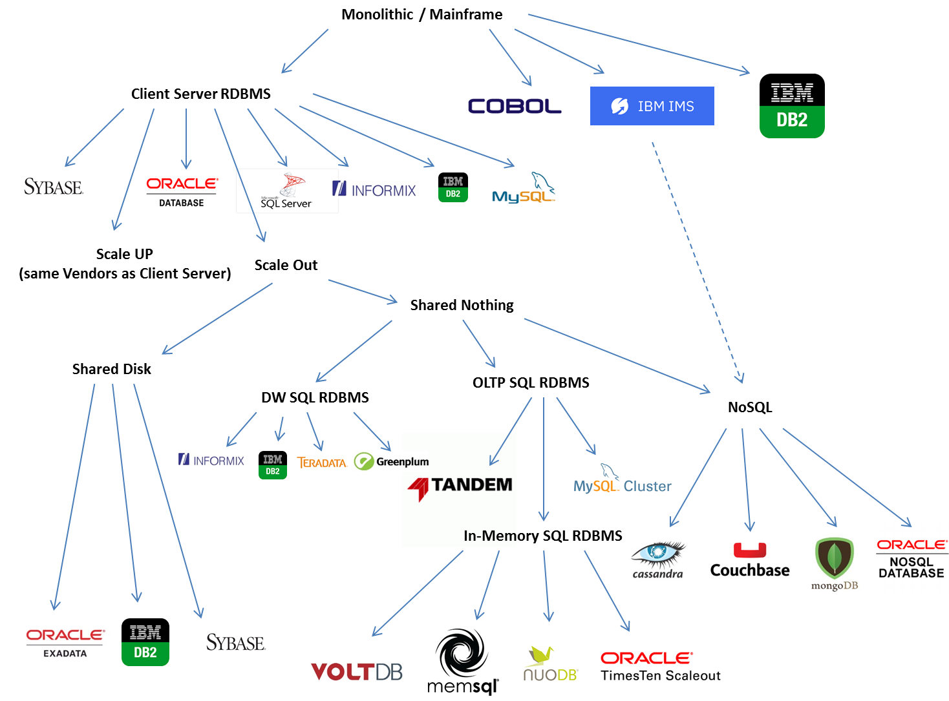
From: https://blogs.oracle.com/timesten/the-evolution-of-db-architectures
(Oracle-focused)

Slide 33
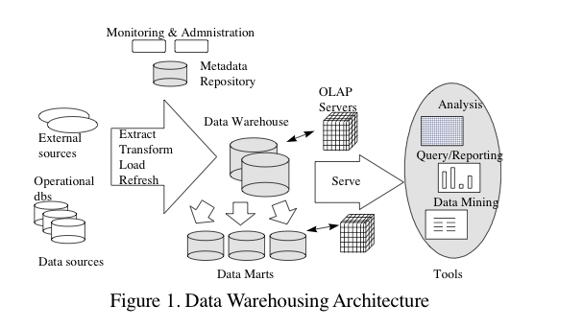
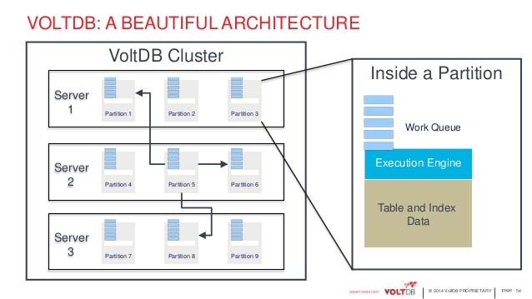
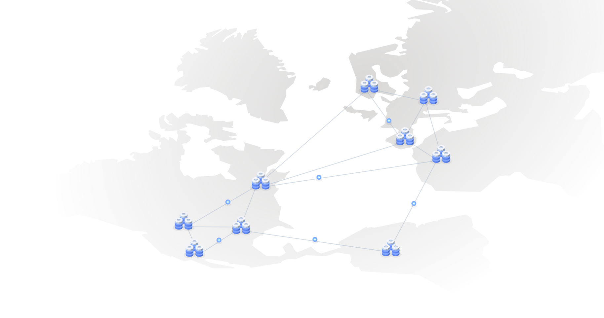
Data Warehouses
For: Large-scale data processing (TBs to PBs)
Parallel architectures (lots of co-located computers)
SQL and Reporting
No transactions
In-memory OLTP (on-line transaction processing)
For: Extremely fast transactions
Many-core or parallel architectures
Very limited SQL – mostly focused on “writes”
Typically assume data fits in memory across servers
Highly available, distributed OLTP
For: Distributed scenarios where clients are all over the world
Focus on “consistency” – how to make sure all users see the same data
Limited SQL – mostly focused on “writes”
Considerations of memory vs disk less important

Slide 34
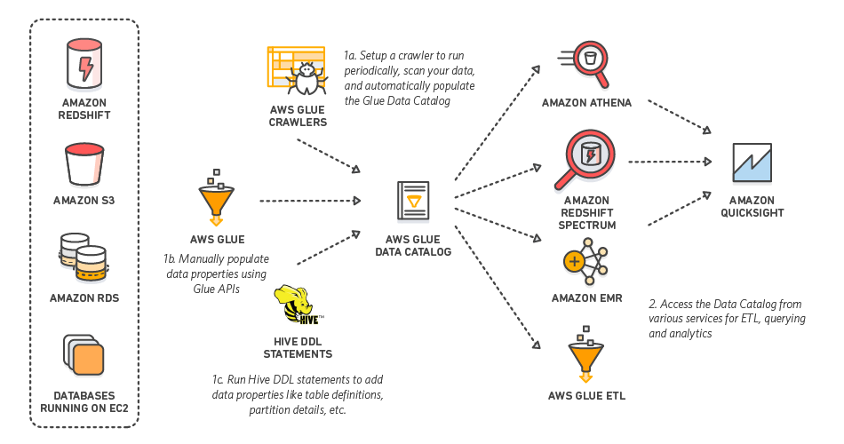
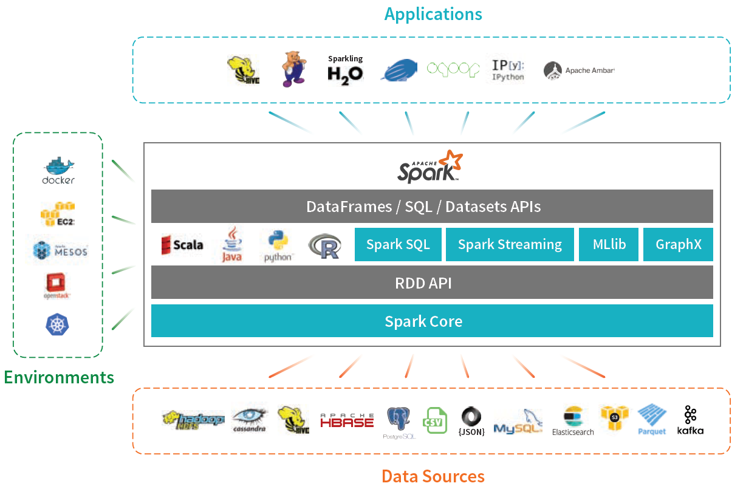
Extract-Transform-Load Systems, or Map-Reduce, or Big Data Frameworks
For: Large-scale, “ad hoc” data analysis
Mix of parallel and distributed architectures
Data usually coming from many different sources
Mix of SQL, Machine Learning, and ad hoc tasks (e.g., do image analysis, followed by SQL)
AWS Glue
Apache Spark

Slide 35
Okay…
Key takeaway: Modern data architectures are all over the place
We haven’t talked about NoSQL (MongoDB, etc.), Machine Learning, “Streaming”…
Fundamentals haven’t changed that much though
We are still either:
Going from some “input datasets” to an “output dataset” (queries/analytics)
Modifying data (transactions)
SQL is still very common, albeit often disguised
Spark RDD operations map nicely to SQL joins and aggregates (unified now)
MongoDB lookups, filters, and aggregates map to joins, selects, and aggregates in SQL
But “performance trade-offs” are all over the place now
30 years ago, we worried a lot about hard disks and things fitting in memory
Today, focus more on networks
Focus has shifted to other aspects of data processing pipelines
Analytics/Machine learning, data cleaning, statistics

Slide 36
What we will cover…
Data Modeling
Data represented in tabular forms (Relational)
JSON/Document Data Model (MongoDB)
Entity-relationship Model for Schema Design
Normalization theory to formally define a ”good” schema
We will discuss a more primitive data model as well (Apache Spark)
Query Languages and Programming Abstractions
SQL, MongoDB Query Language, Apache Spark MapReduce-like Framework, Some others
Query Engines and Big Data Frameworks
Considerations in efficient implementations
Transactions
How to reason about consistency and durability guarantees (ACID)
Basics of how to achieve those guarantees in centralized and distributed settings

Slide 37
What we will cover…
This course is NOT about learning how to write SQL queries
Although we will practice that a fair bit…
It is about learning the foundations of how data management systems are built and why they are built that way, so you:
Can think about the design decisions more systematically (e.g., through use of normalization theory and E-R modeling)
Understand the role of data modeling and how different models impact design decisions
Develop a deeper understanding of the differences and similarities between different types of database systems (e.g., PostgreSQL vs MongoDB)
Are equipped (to some extent) to design next-generation data systems
Are able to reason about performance of the queries/tasks

Slide 38
Structure of the Course
Introduction
Motivation, data abstraction, common data systems architectures today
Relational Model + SQL (Three Programming assignments)
How to model and query data using SQL
How to update data using transactions and considerations therein
Schema Design: Entity-relationship Models and Normalization (One assignment)
How to create a database schema, and how to ensure it is “good”
NoSQL (somewhat of a misnomer) (Two Programming assignments)
Document, key-value, and graph data models
MongoDB and its Query Language
Map-reduce Model and Apache Spark
Implementation Issues
Different types of storage, and how to ensure reliability in presence of failures
Indexes for faster retrieval of data
How an SQL query is processed and optimized
How to do concurrent updates correctly
How to ensure consistency in presence of failures

